Slide 1
Unit 2
Financial Statements I
Balance Sheet
Income Statement

Slide 2
Financial Statements
Elaborated every 12 months (in €), completed within 3 months after closure and signed.
  Balance sheet
  Income Statement (P&L)
  Statement of changes in equity
  Cash Flow Statement
  Notes
Show 2 consecutive years; items can be grouped or subdivided; references to the notes

Slide 3
Abbreviated annual accounts
Balance sheet and notes if 2 circumstances occur in 2 years:
  Total assets ≤ 4.000.000 €.
  Sales ≤ 8.000.000 €.
  Average number of employees ≤ 50
It implies that SCE and CFS are not mandatory.
Only abbreviated P&L if 2 circumstances occur in 2 years:
  Total assets ≤ 11.400.000 €.
  Sales ≤ 22.800.000 €.
  Average number of employees ≤ 250

Slide 4
Abbreviated annual accounts
 | BS and notes abbreviated | Only P&L abbreviated | Listed
Balance | Abbreviated | Normal | Normal
P&L | Abbreviated | Abbreviated | Normal
Notes | Abbreviated | Normal | Normal
SCE | No | Yes | Yes
CFS | No | Yes | Yes
Management report | No | Yes | Yes
Audit report* | Yes | Yes | Yes
*The obligation to audit has its own thresholds, which are lower.

Slide 5
Balance sheet
It represents all resources, rights and obligations that, under the ownership of a natural or legal person, are assigned to a specific purpose and are susceptible to economic valuation.
Equity: the residual part of the assets of the entity after all liabilities have been deducted; it belongs to the owners.
Equity = resources + rights - obligations
Assets = Equity + Liabilities

Slide 6
Balance sheet
Snapshot of a company’s situation
ASSETS | EQUITY
 | LIABILITIES
Use of resources and source of resources
Economic structure and Financial structure
Notes:
Does it matter? Yes! Ferrari (mine or bank) Which is better, E or L? There is no one-fits-all- solution for a company; depends on needs, goals
A boat can be moved by the wind (sails) or by an engine.

Slide 7
Financial components
from least to most liquid | from least to most enforceable
non-current assets (LT) Intangible PPE LT Financial assets current assets (ST) Inventories Receivables Cash | equity Capital Reserves Profit
 | non-current liabilities LT Loans current liabilities ST Loans
Notes:
>12 months
Debtors Clients – Creditors Suppliers
The E also includes other funds that do not have to be returned, such as grants.
Liquidity: ability to convert assets into cash
Solvency: ability to meet debts

Slide 8
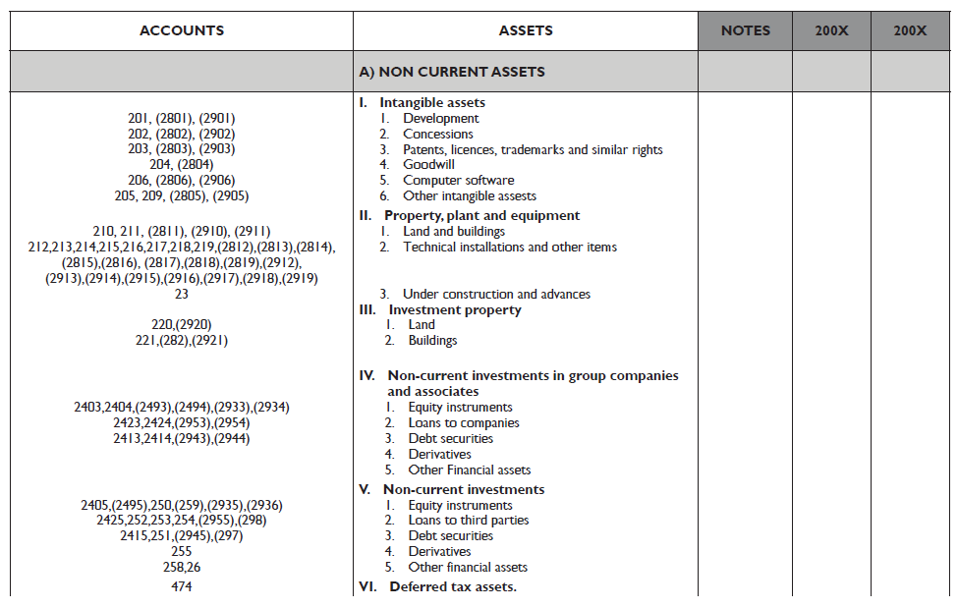

Slide 9
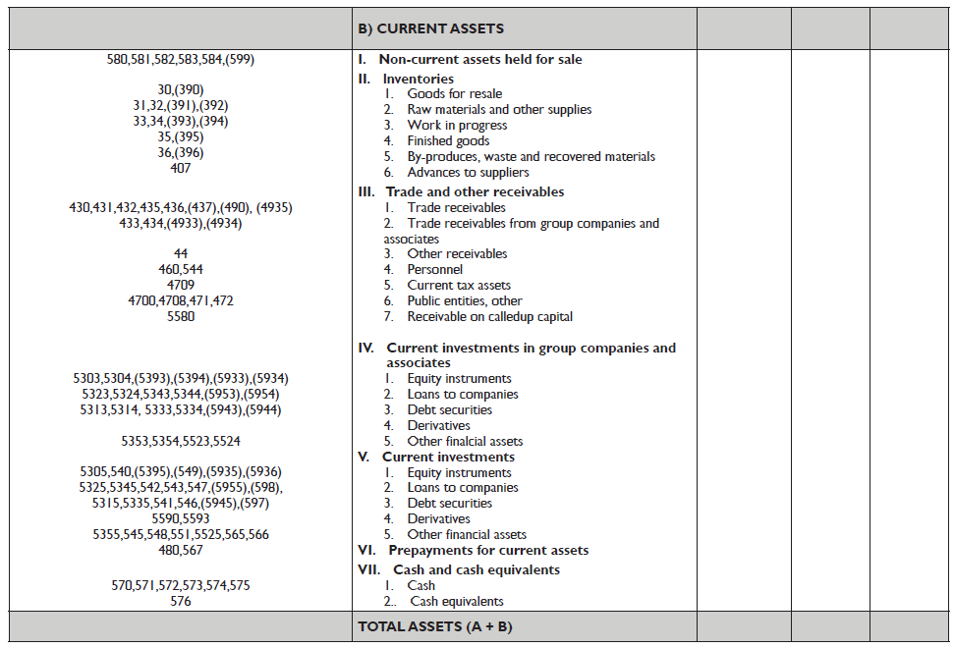

Slide 10
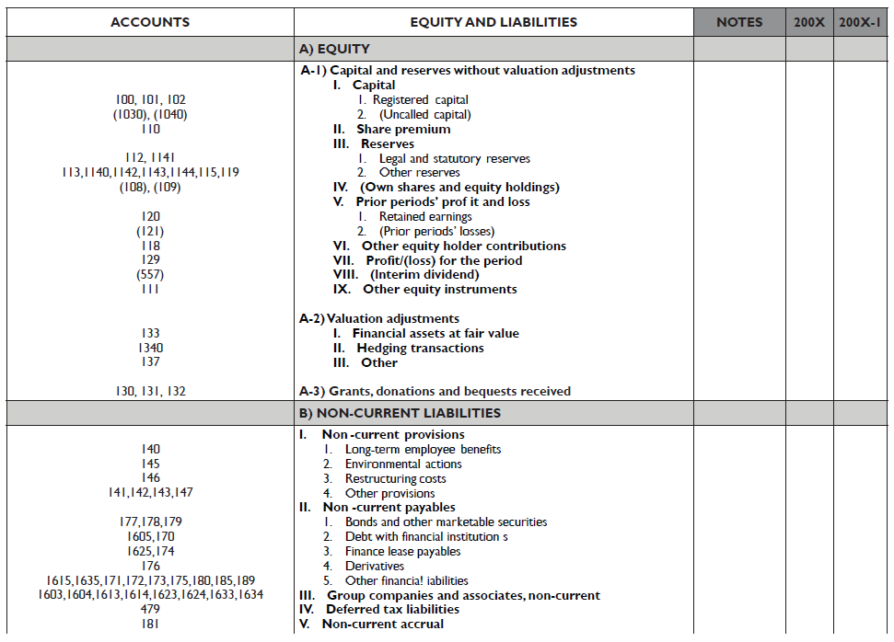

Slide 11
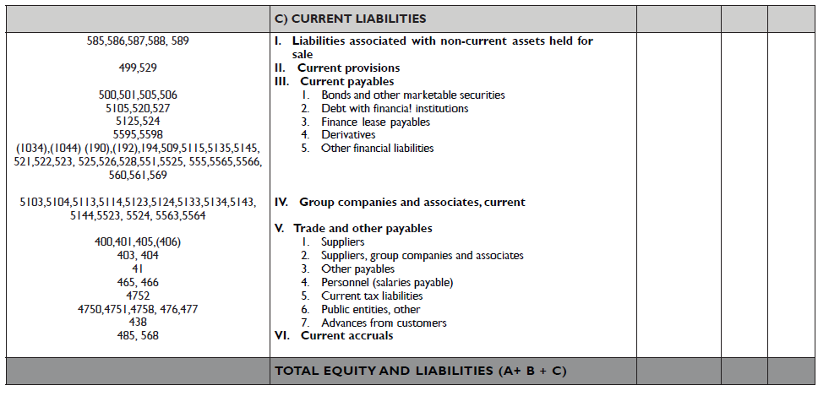

Slide 12
Income Statement
ASSETS | EQUITY
 | LIABILITIES
REVENUES
EXPENDITURES
NET PROFIT OR LOSS
Expense: a decrease in equity (value) that is not due to distributions to owners

Slide 13
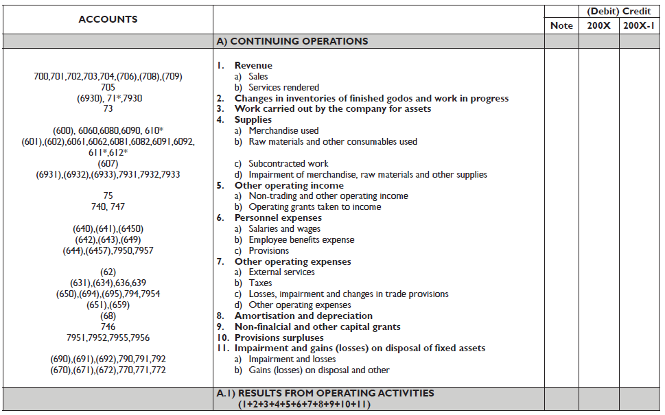

Slide 14


